Slide 1
Investigation of Image Classification based on Transfer Learning and Siamese Network
Ke Fan, Abdullateef Almudaifer, Sungman Kang

Slide 2
Agenda
Objective
Dataset Processing
Transfer Learning
Implementation 1
Siamese Network
Implementation 2
Evaluation

Slide 3
Objective
Compare a simple Siamese network features with transfer learning approach on shoes dataset classification accuracy.
Investigate the effect of Siamese network on the features from transfer learning.

Slide 4
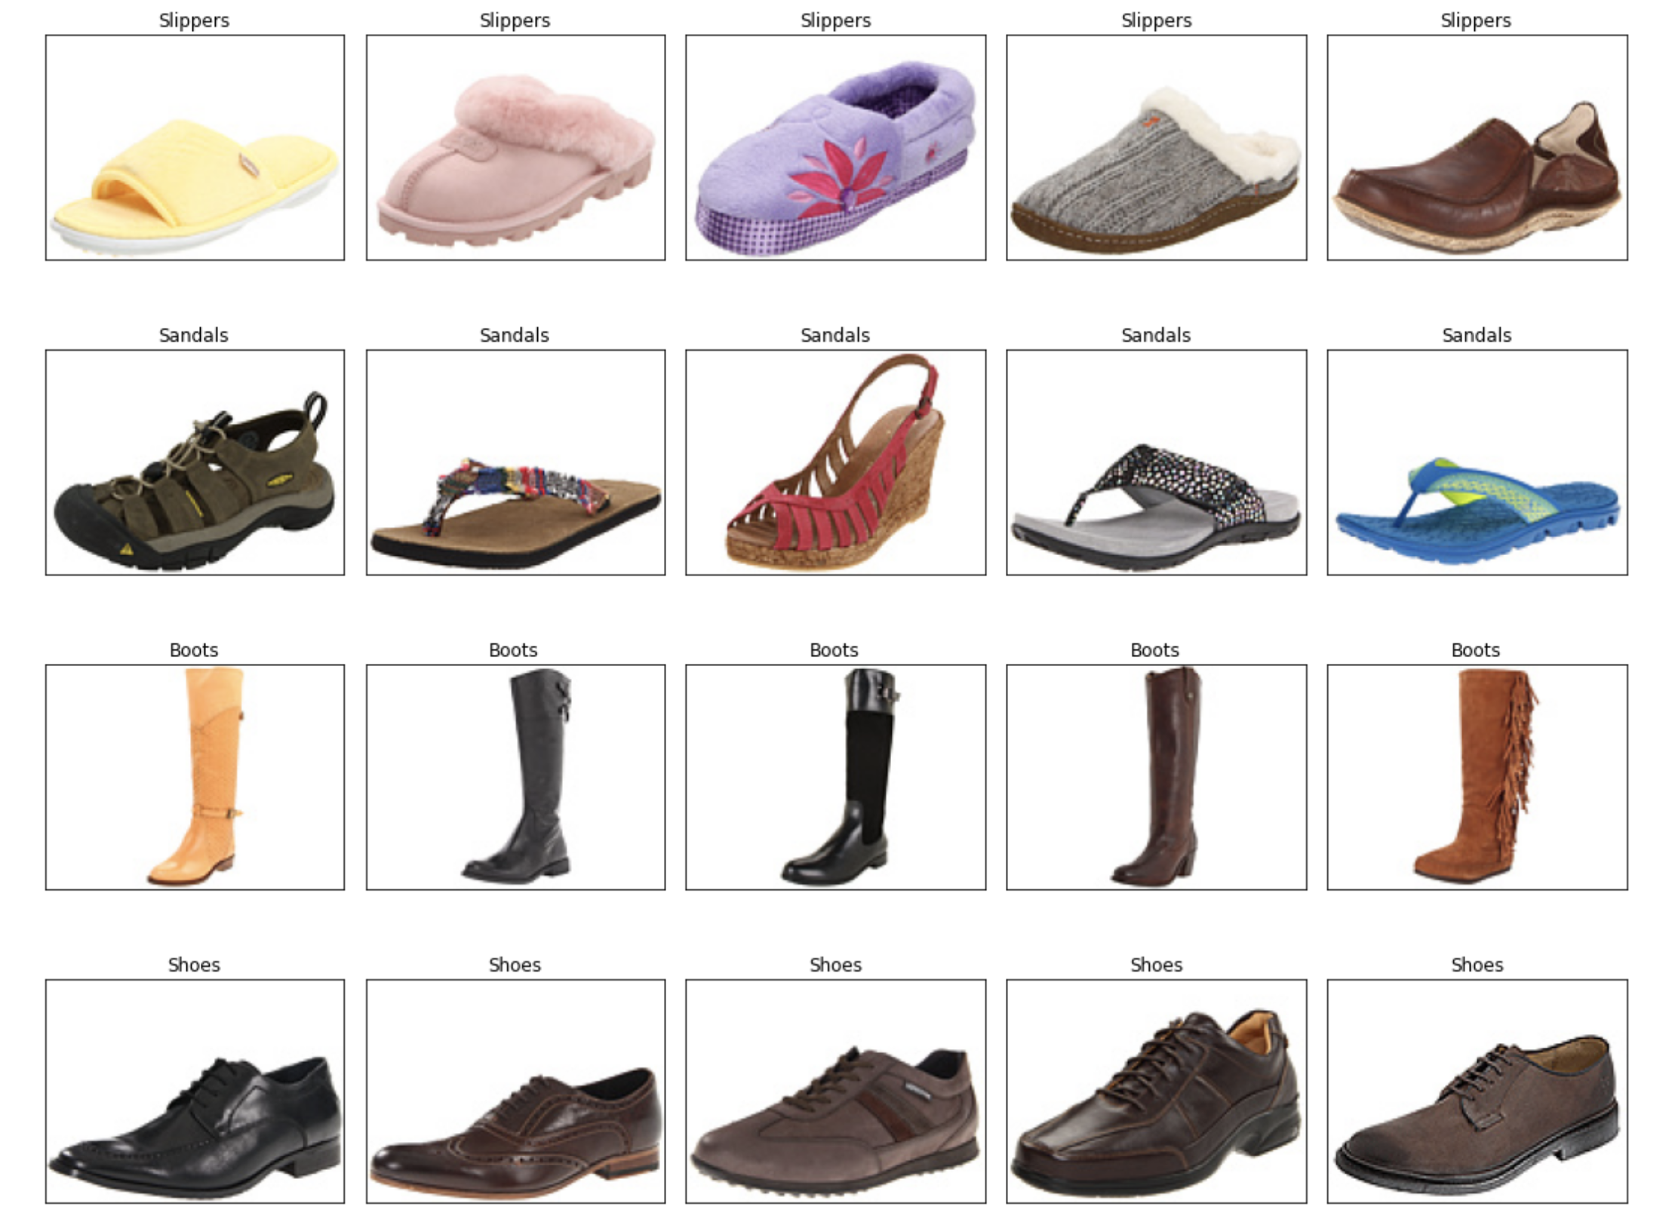
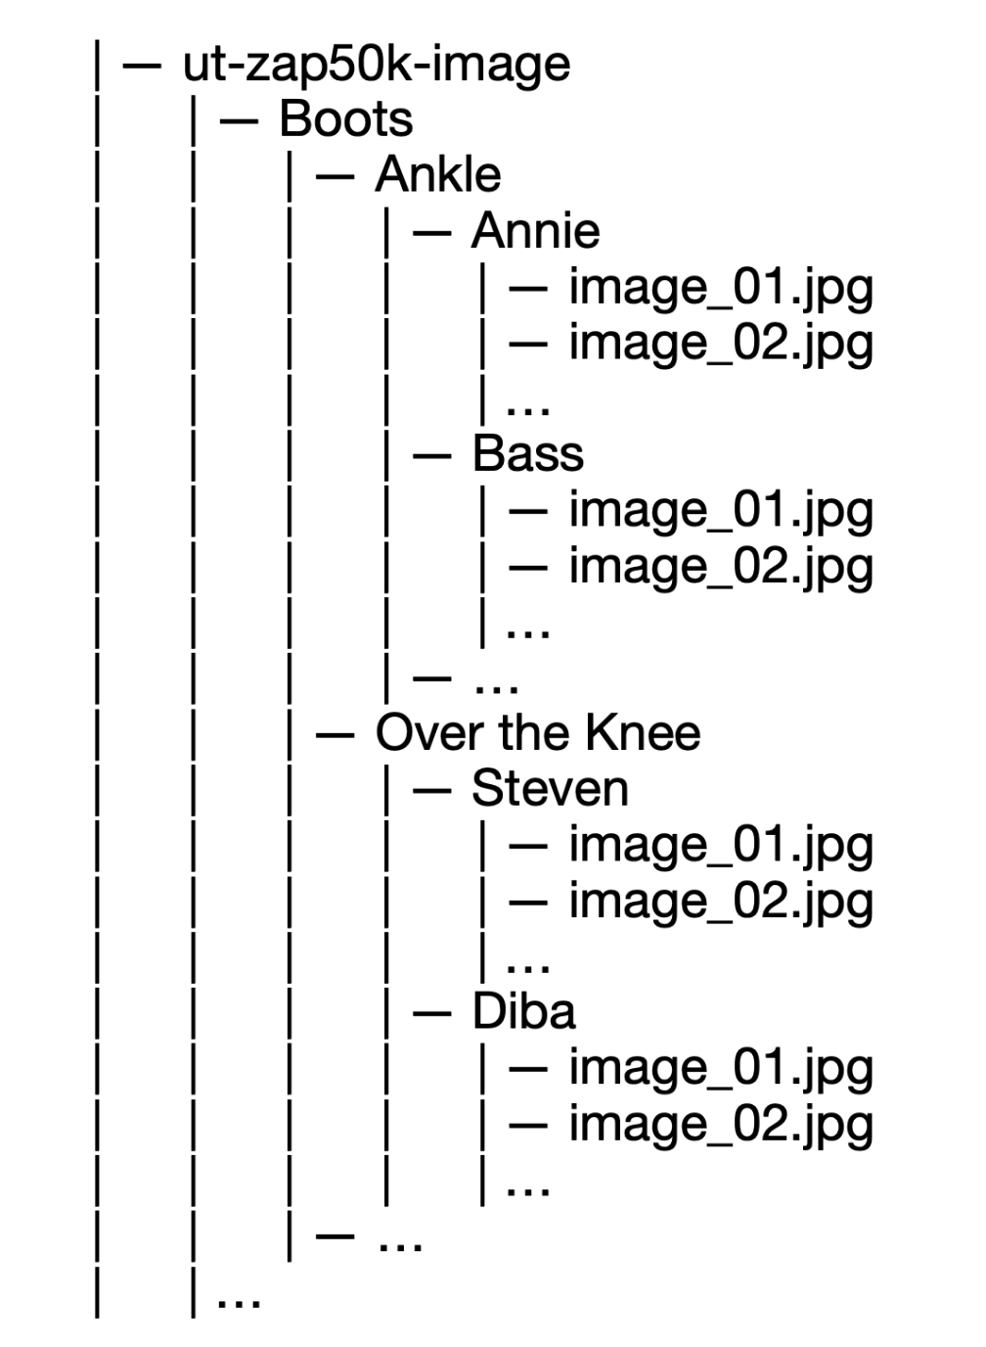
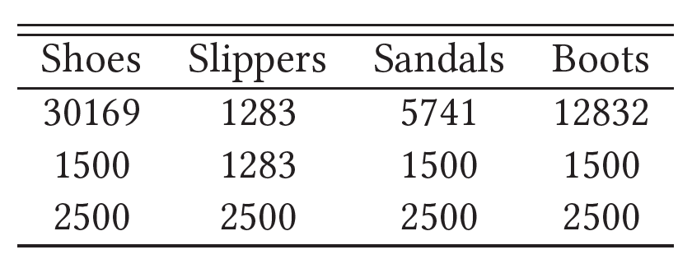
Dataset
Figure 1: Examples from the dataset.
http://vision.cs.utexas.edu/projects/finegrained/utzap50k/

Slide 5
Transfer Learning

Slide 6
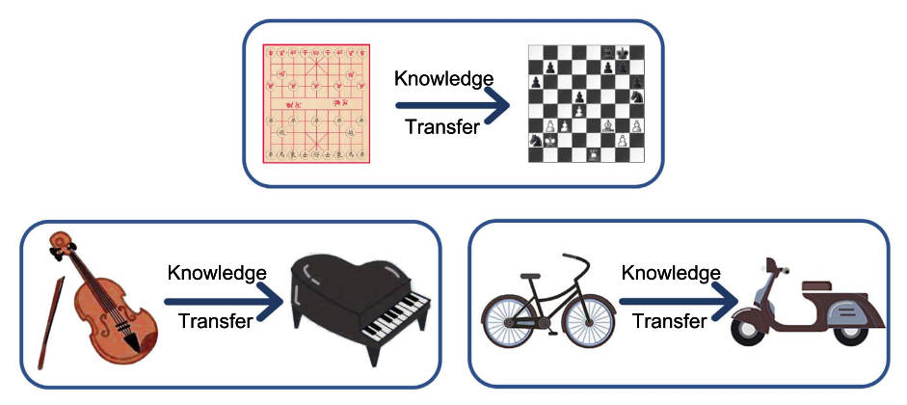
Transfer Learning
Figure 2: Intuitive examples about transfer learning.
Source: A Comprehensive Survey on Transfer Learning https://arxiv.org/pdf/1911.02685.pdf

Slide 7
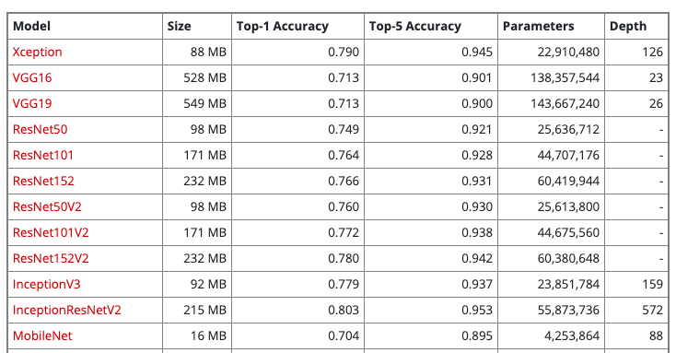
Xception
Table 1: part of available models on Keras applications
https://keras.io/api/applications/

Slide 8
Xception
Fig. 3: Xception architecture
Xception: Deep Learning with Depthwise Separable Convolutions https://arxiv.org/pdf/1610.02357.pdf

Slide 9
Implementation
scores
Probabilities
shoes
shoes
G.A.B
sandals
softmax
sandals
Xception
slippers
slippers
3, 3, 2048
2048
boots
boots
scores
Probabilities
shoes
shoes
FC
+
Relu
G.A.B
sandals
softmax
sandals
Xception
slippers
slippers
2048, 3, 3
2048
boots
boots
512
Figure 4: implemented transfer learning architectures. G.A.B: GlobalAveragePooling

Slide 10
Siamese Network
Notes:
Hi, this is ke. I will introduce the siamese network.

Slide 11
Siamese Network
Img
CNN
Shared weights
…
…
…
Loss
Shared weights
Img
CNN
Input image
Sub-networks
Embeddings
Figure 5: Siamese Network.
Notes:
A Siamese Network is a class of neural network architectures that contain two or more identical subnetworks. ‘identical’ here means, they have the same configuration with the same parameters and weights. Parameter updating is mirrored across all the sub-networks. A sub-network is typically a CNN model, and all the sub-networks are connected by a loss function. And Siamese Network is normally used to measure the similarity between the input images. This network is able to learn from very small dataset. So it is popular in recent years.

Slide 12
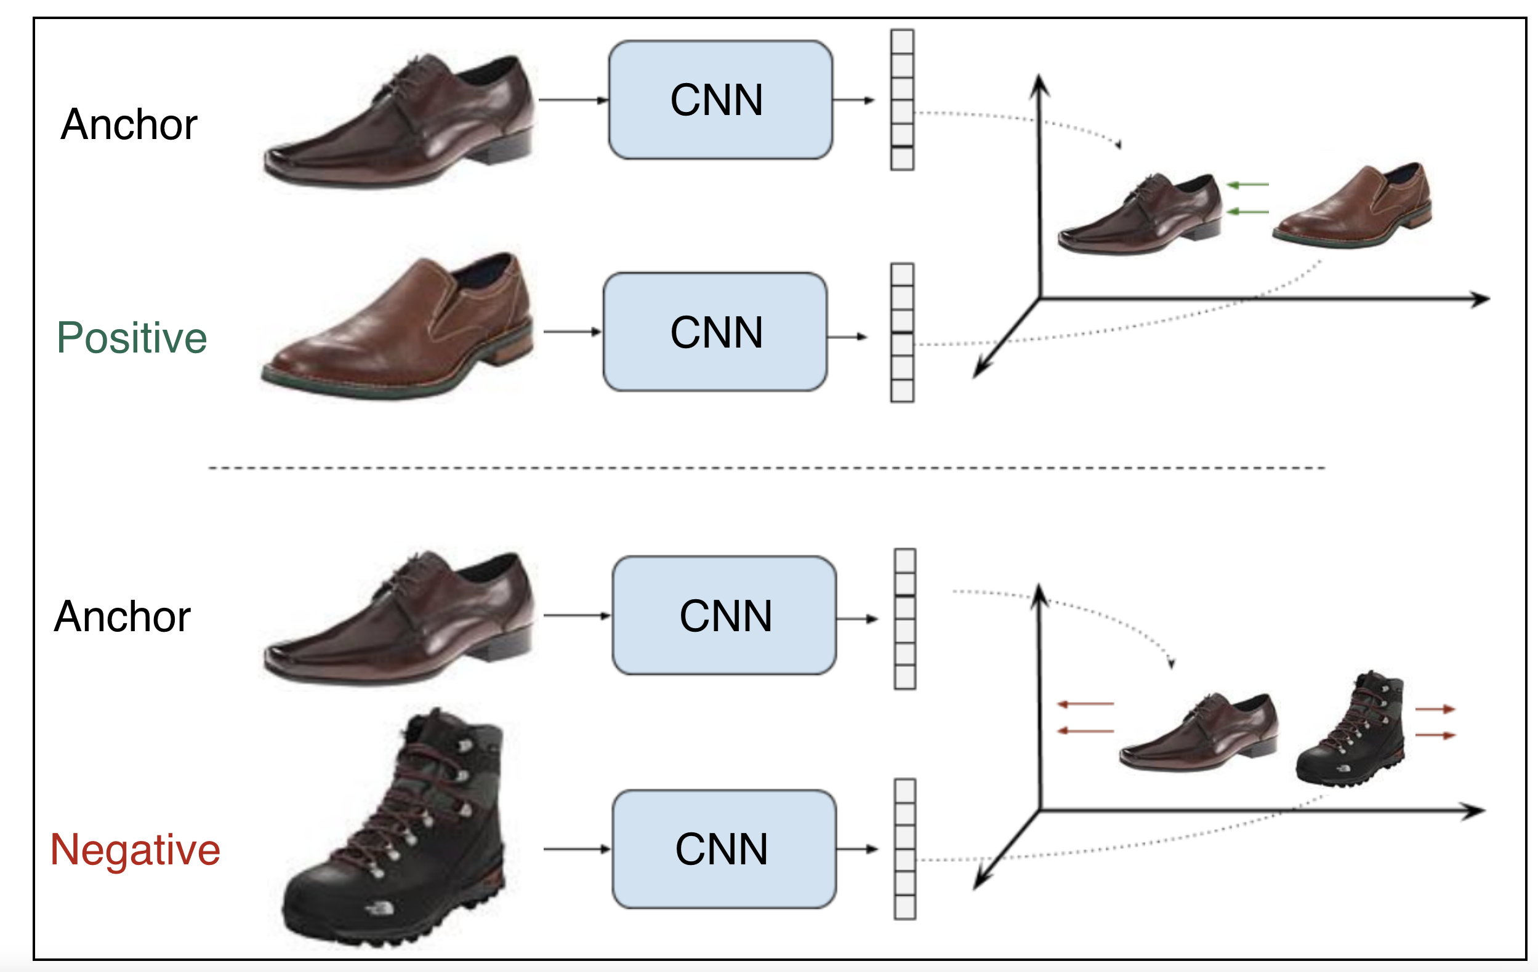
Contrastive Loss
Shared weights
pull
[1]
push
Shared weights
[0]
Figure 6: Example of a contrastive ranking loss training setup
SCHOOL OF - to apply in all slides at the same time edit in Insert > Header & Footer
Notes:
There are two famous and widely used architectures of the Siamese Network, which are designed based on two different loss functions. The first one is shown as the figure. This architecture takes pairs of images as the inputs. And the pairs contain the positive pairs and the negative pairs. Positive pairs are composed of an anchor sample and a positive sample, which is very similar to the anchor. And negative pairs contain an anchor sample and a negative sample, which is dissimilar to the anchor. And they are labeled with 1 and 0 respectively. The objective is to learn representations with a small distance between the two images in the positive pairs, and a greater distance than a margin value for negative pairs.

Slide 13
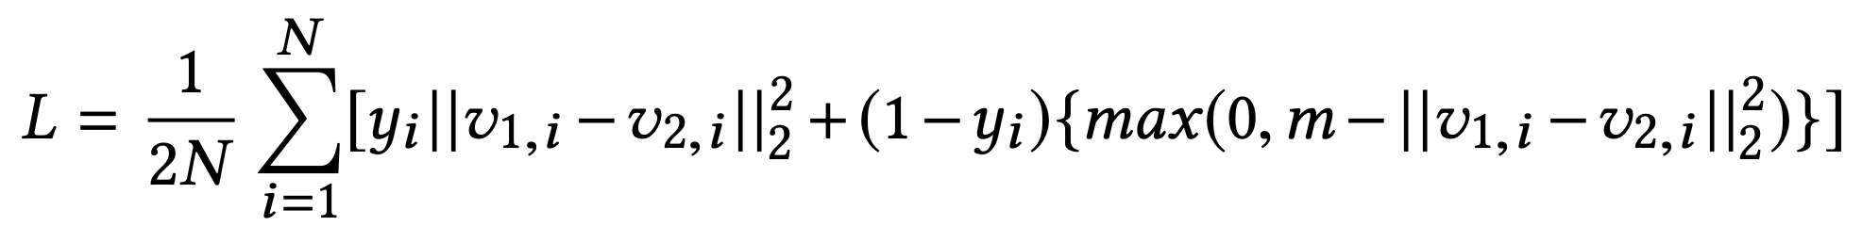
Contrastive Loss Function
$$v_{1,i},v_{2,i}$$
: embedding vectors of the two samples in a pair
$$y_{i}$$
: binary label (1 for a positive pair and 0 for a negative pair)
m: margin, N: the number of batches
SCHOOL OF - to apply in all slides at the same time edit in Insert > Header & Footer
Notes:
The loss function can be expressed by this formula. For positive pairs, the loss will be 0 only when the networks produce embeddings for the two pair elements with no distance between them, and loss will be increased with this distance. For negative pairs, the loss will be 0 when the distance between the embeddings of two pair elements is greater than the margin m. But when that distance is not bigger than m, the loss will be positive, and parameters will be updated to produce more distance between them.
The function of the margin is that, when the representations produced for a negative pair are distant enough, no efforts are wasted on enlarging that distance, so further training can focus on more difficult pairs.

Slide 14
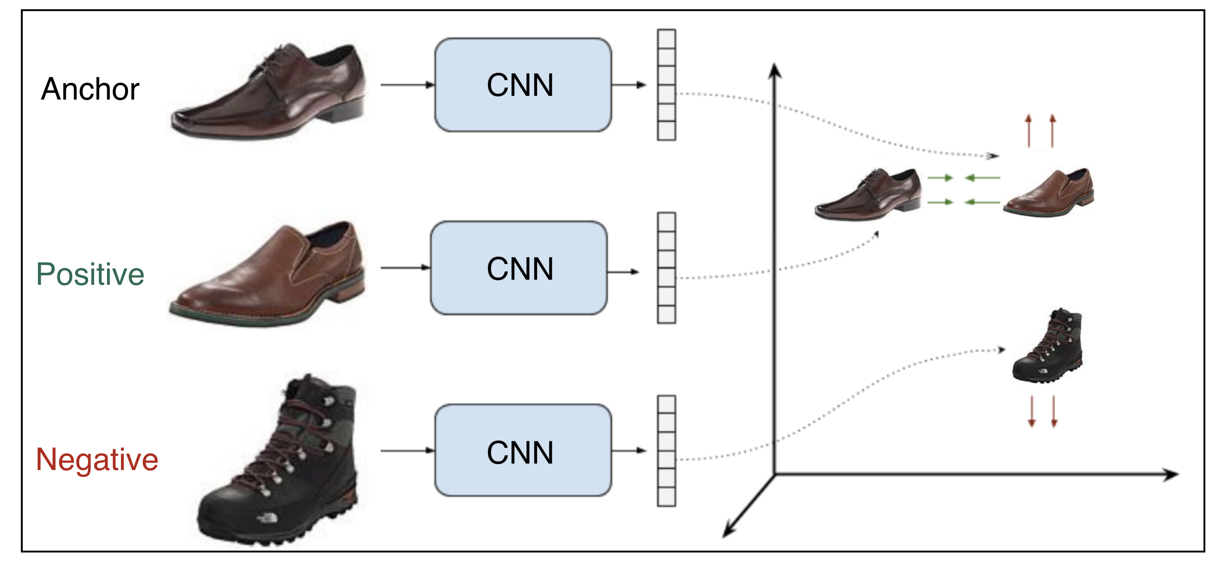
Triplet Loss
Shared weights
pull
push
Shared weights
Figure 7: Example of a contrastive ranking loss training setup
SCHOOL OF - to apply in all slides at the same time edit in Insert > Header & Footer
Notes:
The other one is based on the triplet loss. This network takes triplets as the inputs. The triplets are formed by an anchor sample, a positive sample, and a negative sample. The objective is that the distance between the anchor sample and the negative sample representations is greater than the distance between the anchor and positive representations plus the margin m.

Slide 15
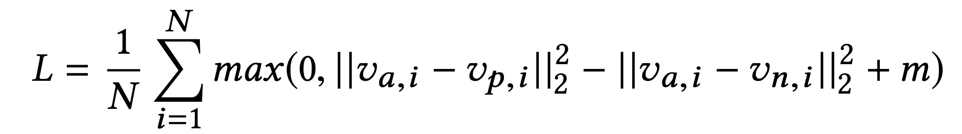
Triplet Loss Function
$$v_{a,i},v_{p,i},v_{n,i}$$
: embedding vectors of the anchor, positive, negative in a triplet
m: margin, N: the number of batches
Easy Triplets:
$$d(v_{a,i},v_{n,i})>d(v_{a,i},v_{p,i})+m$$
Hard Triplets:
$$d(v_{a,i},v_{n,i})<d(v_{a,i},v_{p,i})$$
Semi-Hard Triplets:
$$d(v_{a,i},v_{p,i})<d(v_{a,i},v_{n,i})<d(v_{a,i},v_{p,i})+m$$
SCHOOL OF - to apply in all slides at the same time edit in Insert > Header & Footer
Notes:
This is the formula. The loss will be 0 when the distance between the anchor and the negative is larger than the distance between the anchor and the positive plus margin. Note that, we don't need any labels in this network. And based on the two distances, there are three situations, called easy triplets, hard triplet, and semi-hard triplets.

Slide 16
Implementation
Notes:
In this project, we implemented three variants of the siamese network.

Slide 17
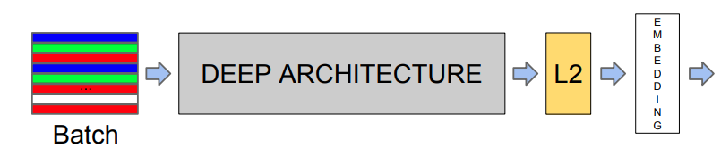
Architecture
32
512
Loss
FC
Classes
Figure 8: Implementation of Siamese Network
SCHOOL OF - to apply in all slides at the same time edit in Insert > Header & Footer
Notes:
This is the architecture of our network. It consists of a batch input layer and a deep CNN followed by L2 normalization, which results in the image embedding. This is followed by a loss function during training. And then we fed the trained embedding into a fully connected neural network to generate the classification output.

Slide 18
Implementation
Offline pair mining
defined before training
Online triplet mining
defined for every batch during training
Notes:
The first implementation is the network with contrastive loss. In this implementation, we used the offline pair mining strategy, which means that pairs are defined at the beginning of the training. The second implementation is the network with triplet loss. In this implementation, we used online triplet mining, meaning that triplets are defined for every batch during the training. And the latter one has been proved in better training efficiency and performance. Furthermore, we implemented the contrastive loss function by ourselves, while we implemented the triplet loss function by calling the TripletSemiHardLoss function in TensorFlow.

Slide 19
Pairs
Label [1]
Label [0]
Figure 9: Pair examples
Notes:
Here are the examples of the pairs we made for the first implementation. The positive sample is randomly picked from the same class with the anchor. And the negative sample is randomly picked from the classes that are different from the anchor.

Slide 20
Triplets
Figure 10: Triplet examples
Notes:
Here are the examples of the triplets. We used the same strategy as the pairs. They don't need labels.

Slide 21

CNN Architecture
(102x102x3)
(64, 2 x 2 filters)
102x102x64
(2 x 2 stride)
(64, 2 x 2 filters)
40,000
2048
512
4
51x51x64
51x51x64
1
2
3
(2 x 2 stride)
25x25x64
4
Figure 11: CNN Architecture
Notes:
This is the architecture of our CNN model. And we show all the parameters we used here.

Slide 22
Xception + Siamese Network
(102x102x3)
1024
512
(2048,3x3)
(2048)
1
2
3
Xception
G.A.B
4
XCEPTION
G.A.B
Figure 12: Xception + Siamese Network
Notes:
Furthermore, in order to improve the performance of the siamese network, we implemented another version with transfer learning. As shown in the figure, we used the Xception to extract the features firstly, followed by a global average pooling layer, and applied two dense layers on top of that.

Slide 23
Evaluation

Slide 24
Evaluation – old run
model | Accuracy % | Epochs | Time (mins)
Xception (T0) | 91.8 | 20 | 1.8
Xception + dense (T1) | 90.7 | 20 | 3.5
Xception All (T2) | 95.1 | 10 | 5.4
Our Siamese + Con. Loss (S0) | 92.75 | 32 | 6
Our Siamese + Triplet. Loss (S1) | 91.02 | 20 | 2
Xception + Siamese (S2) | 95.85 | 10 | 2
model | Accuracy % | Epochs | Time (mins)
Xception (T0) | 89.9 | 20 | 4
Xception + dense (T1) | 89.3 | 20 | 4
Xception All (T2) | 94.0 | 10 | 6
Our Siamese + Con. Loss (S0) | 90.20 | 32 | 14
Our Siamese + Triplet. Loss (S1) | - | - | -
Xception + Siamese (S2) | - | - | -
Table1: Results on 1500 images
Table2: Results on 2500 images

Slide 25
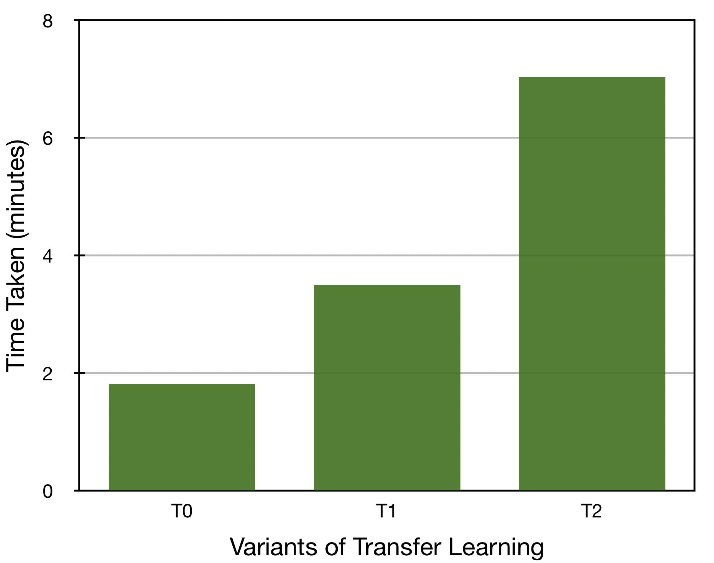
Comparison of Transfer Learning
Figure 13: Comparison of Accuracy and Time taken of Transfer Learning

Slide 26
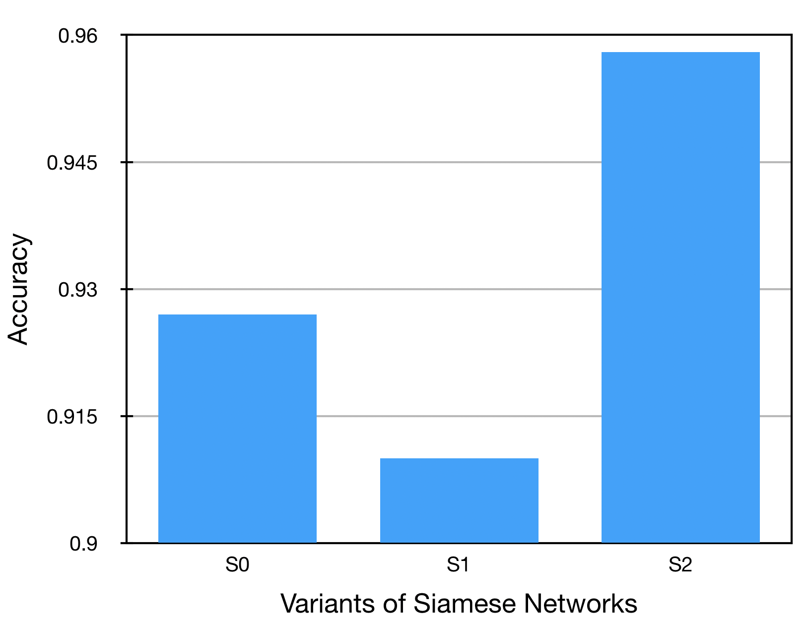
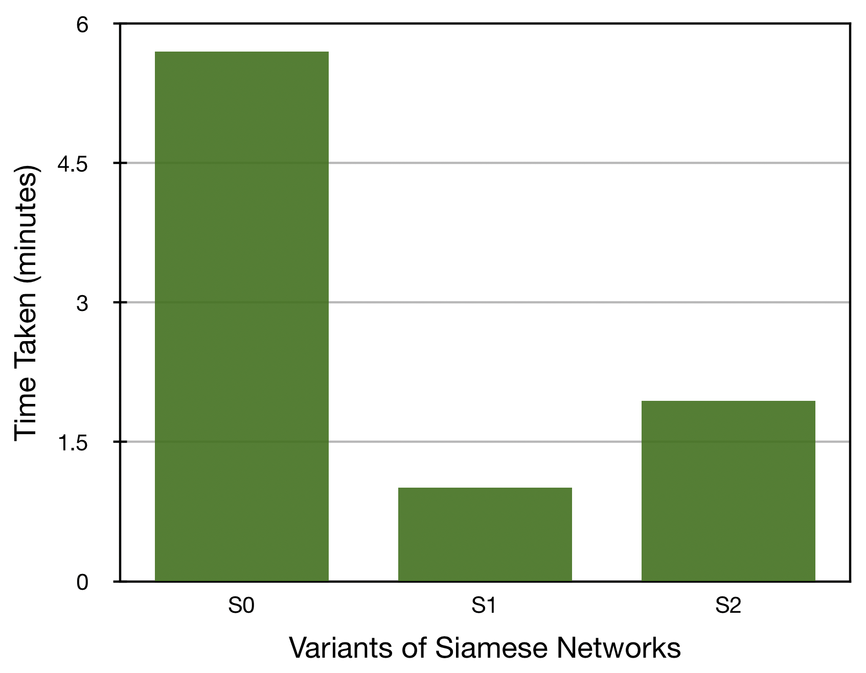
Comparison of Siamese Network
Figure 14: Comparison of Accuracy and Time taken of Siamese Network

Slide 27
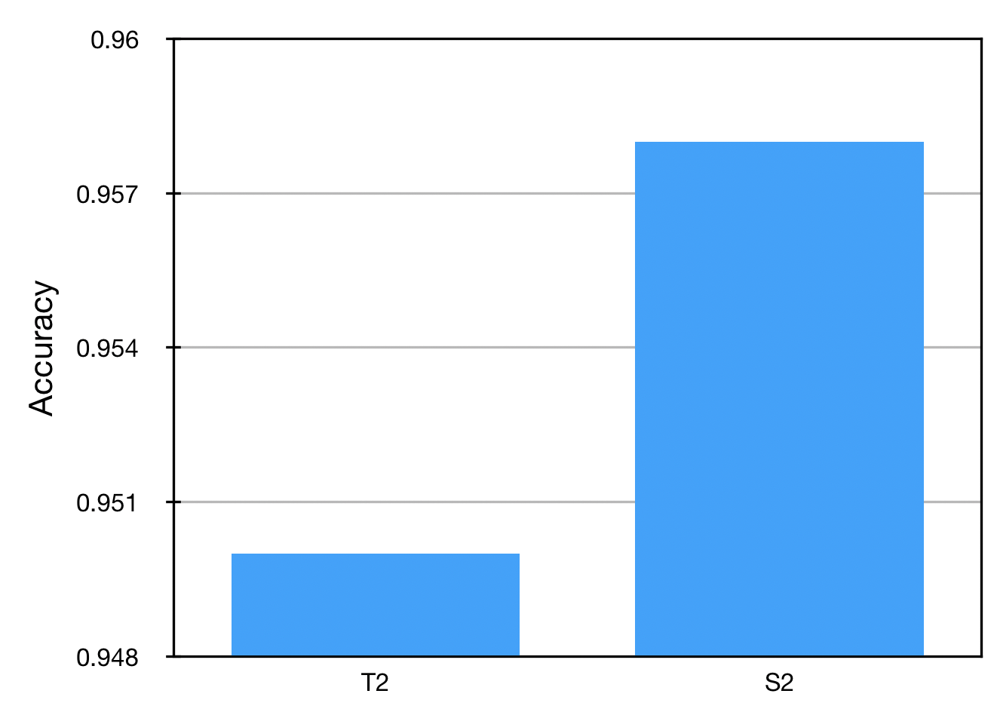
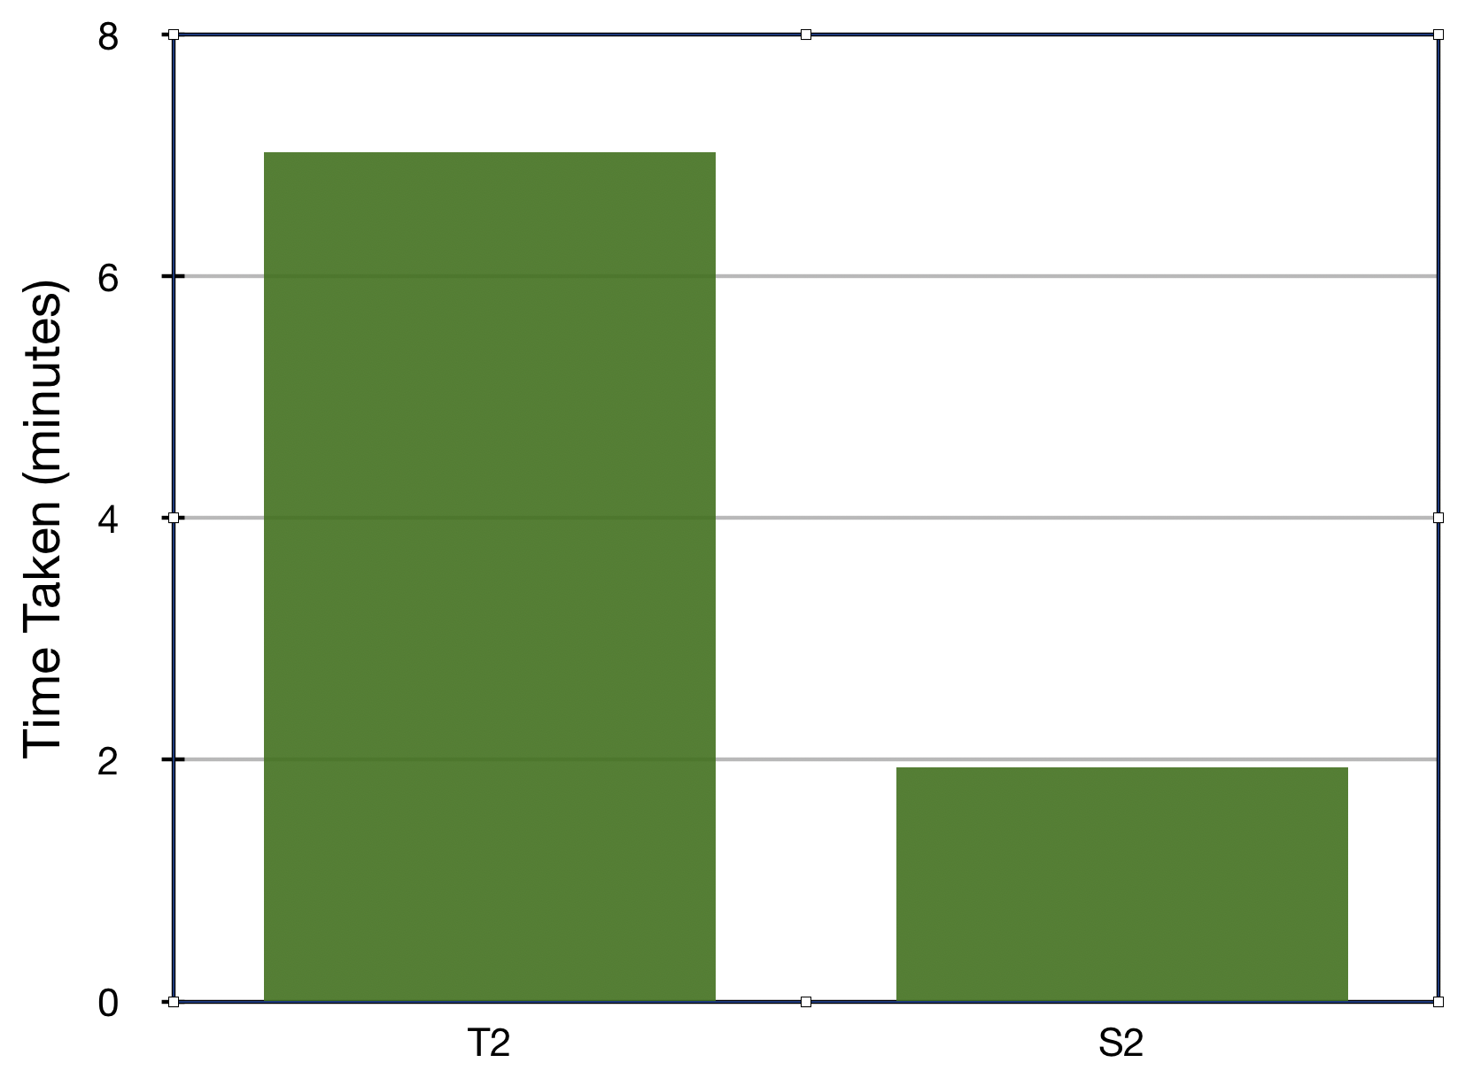
Comparison best models
Figure 15: Comparison of Accuracy and Time taken of two Best Models

Slide 28
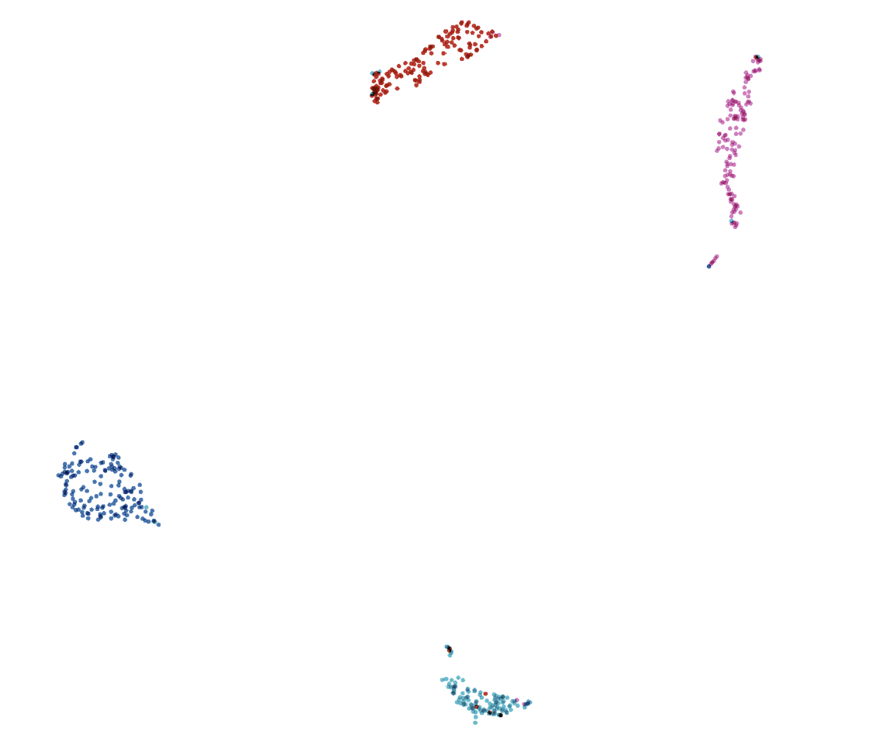
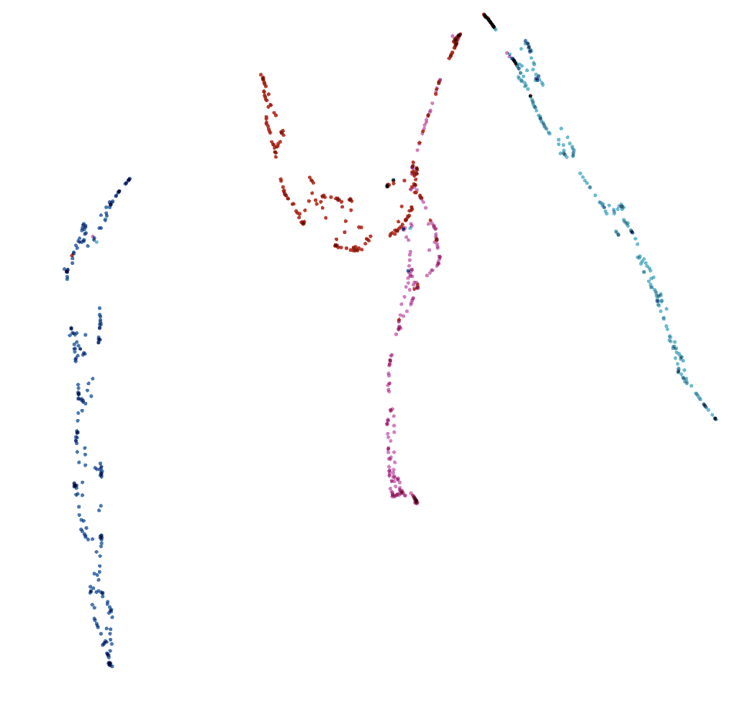
Comparison best models
(a) Xception + Siamese
(b) Xception all
Figure 16: visualization of embedded test data projected to 2D space with UMAP using https://projector.tensorflow.org/

Slide 29
Thank you!

Slide 30
Do you have question?

